Slide 1
DATA PIPELINE EXERCISE
Olist E-Commerce ELT Pipeline
Azure Data Factory + Self-Hosted Integration Runtime + Azure Databricks + Azure SQL Database
Bhanu Teja Chindukuri

Slide 2
BRIEF
Objective
▪ Build an ELT pipeline over the complete Kaggle Olist Brazilian e-commerce dataset — all 9 files, ~1.55M source rows.
▪ Two source types: CSV files in cloud object storage, and relational tables in a database (Oracle in the brief; substituted with PostgreSQL — noted per the brief's own instruction).
▪ Transform with PySpark on Azure Databricks.
▪ Load typed, query-ready tables into Azure SQL Database, with per-entity process logging, reconciliation, and data-quality flags built in.
▪ The full real dataset was reviewed locally before the first cloud run, and the transform design reflects what that review turned up.
Source: Data Pipeline Exercise.docx (original brief) · README.md

Slide 3
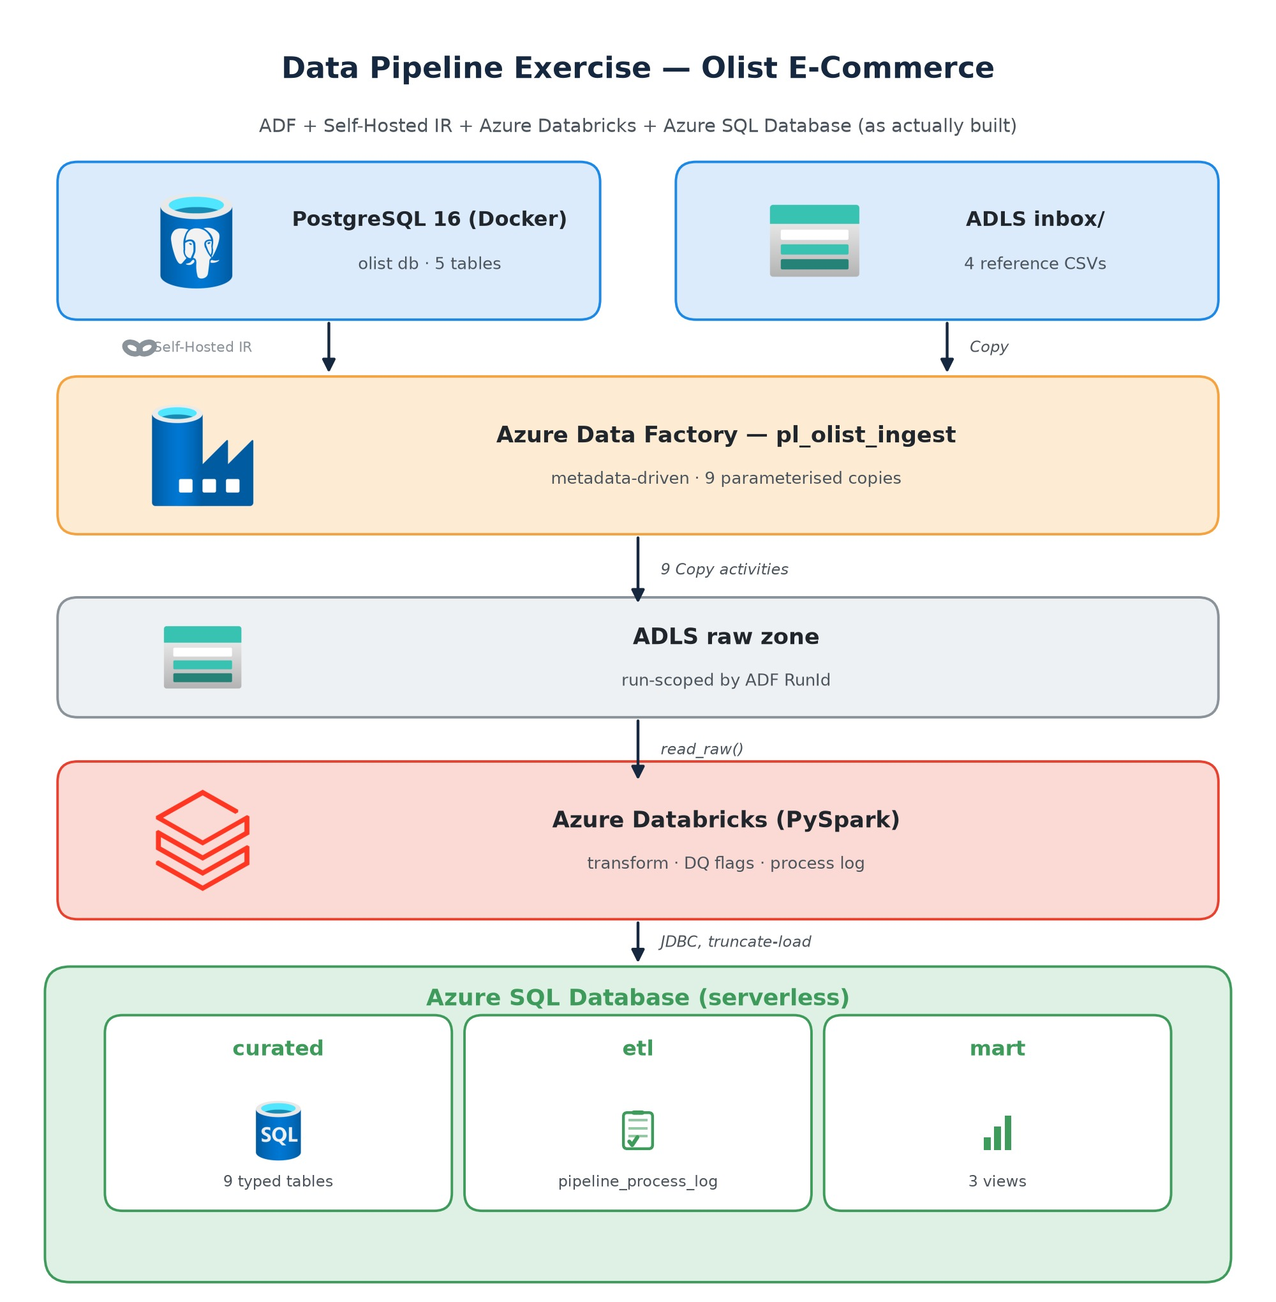
ARCHITECTURE
As-Built Architecture
▪ PostgreSQL 16 (Docker) reached by ADF through a Self-Hosted Integration Runtime — the on-prem-source pattern, pointed at Postgres instead of Oracle.
▪ ADLS Gen2 inbox → raw zone, run-scoped: raw/<entity>/run_id=<ADF RunId>/.
▪ 9 parameterised Copy activities, metadata-driven from config/entities.json (Lookup → Filter ×2 → ForEach ×2).
▪ Azure Databricks (PySpark): rename · cast · null handling · dedup · DQ flags · ingestion metadata · per-entity process logging.
▪ Azure SQL Database (serverless): curated (9 tables) · etl.pipeline_process_log · mart (3 views).

Slide 4
ARCHITECTURE
Design Principles
Dumb ingestion, smart transformation
Copy activities do 1:1 structural moves only; a transform bug never forces re-extraction.
Run-scoped raw zone
Every run lands under raw/<entity>/run_id=<guid> — each run is reproducible against its exact input.
Flag, don't drop
Invalid payment types and impossible delivery dates are kept and flagged; legitimate business nulls are preserved and documented.
Operational metadata everywhere
Every curated row carries ingestion_timestamp + pipeline_run_id; every entity load writes read/written/flagged counts to etl.pipeline_process_log.
Verify before you spend
The whole transform layer runs locally against the real files first; the cloud phases only have to prove the seams (auth, copies, JDBC).

Slide 5
ARCHITECTURE
Services Used
Service | Role | Why this one
Azure Data Factory | Orchestration + ingestion | Copy activity covers both source connectors natively; SHIR demonstrates the on-prem-source pattern; Monitor gives free observability
Self-Hosted Integration Runtime | Bridge to local Postgres | The relational source lives outside Azure — exactly how on-prem Oracle is reached in production ADF setups
ADLS Gen2 | Landing zones (inbox, raw) | Decouples extraction from transformation; parquet as the typed intermediate
Azure Databricks (PySpark) | Transformation | Set-based, testable transforms; config-driven entity pipeline + window-function dedup are natural in Spark
Azure SQL Database (serverless) | Analytical target | Queryable SQL target required; auto-pause keeps cost near zero for ~570k curated rows
Databricks-native secret scope | Secrets | Subscription blocks Key Vault RBAC / managed identity; secrets live in Databricks' own store instead

Slide 6
DATA MODEL
Entities & Transformations
Entity | Source | Rows in → curated | Key transformations
orders | Postgres | 99,441 → 99,441 | Timestamp casts, lower-cased status, is_valid_delivery_date flag (0 flagged), dedup
customers | Postgres | 99,441 → 99,441 | INITCAP city, upper state; customer_unique_id documented as person-level key
order_items | Postgres | 112,650 → 112,650 | Int/decimal/timestamp casts, dedup on (order_id, order_item_id)
order_payments | Postgres | 103,886 → 103,886 | is_valid_payment flag — catches exactly 3 not_defined rows, kept not dropped
order_reviews | Postgres | 99,224 → 99,224 | Multiline-quoted CSV; review_id alone NOT unique (789 dup) → key is (review_id, order_id)
products | inbox CSV | 32,951 → 32,951 | Rename *_lenght typo columns, COALESCE(category,'unknown') — 610 nulls
sellers | inbox CSV | 3,095 → 3,095 | INITCAP city, upper state, dedup
geolocation | inbox CSV | 1,000,163 → 19,015 | Zip-prefix-grain dimension — see judgement call
category translation | inbox CSV | 71 → 71 | UTF-8 BOM neutralized; 2 categories have no translation → mart falls back to Portuguese

Slide 7
DATA MODEL — JUDGEMENT CALL
Geolocation: 1M Points → 19,015-Zip Dimension
rows_read = 1,000,163 → rows_written = 19,015 (a deliberate grain change, not a reconciliation failure)
▪ The raw file is a 1,000,163-row point cloud with no key — many rows per zip prefix.
▪ Its only consumers (customers / sellers) join at zip-prefix grain, not point grain.
▪ A 1M-row JDBC truncate-load into min-capacity serverless SQL costs minutes-to-tens-of-minutes per run for a table nothing can join at that grain.
▪ Decision: ADF still lands all 1M rows in raw (dumb ingestion, full fidelity retained); the curated table is a 19,015-row zip dimension — centroid lat/lng averaged per zip, modal city/state, point_count per zip.
▪ 29 out-of-bounds points excluded from centroids but counted in invalid_point_count; 4 zips whose points are all invalid kept with NULL coordinates.

Slide 8
DATA MODEL
Consumption Layer — Mart Views
Proof that both source systems (relational Postgres + file-based CSVs) come together as one integrated, analytically-queryable dataset.
mart.v_sales_overview
Orders, GMV and avg delivery days by state × English category name (translation LEFT JOIN with Portuguese fallback); delivered + DQ-valid orders only.
mart.v_payment_mix
Order coverage, value share and instalment behaviour per payment type — credit_card 76,795 · boleto 19,784 · voucher 5,775 · debit_card 1,529; the 3 not_defined rows excluded, visible in the DQ evidence.
mart.v_review_delivery
Avg delivery days and %-late per review score — 1★ 11,424 · 2★ 3,151 · 3★ 8,179 · 4★ 19,142 · 5★ 57,328 — makes the late-delivery → bad-review story queryable.

Slide 9
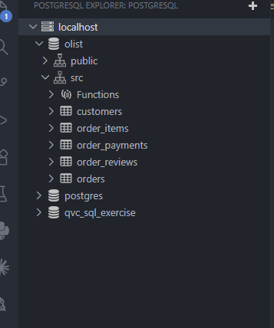
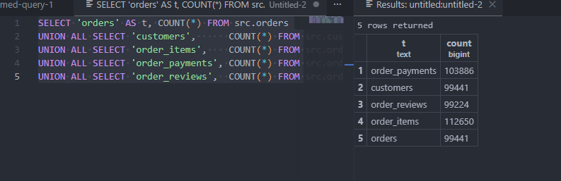
CLOUD EXECUTION
Evidence — Source Systems
PostgreSQL 16 (Docker) — olist DB, src schema, 5 transactional tables
Row counts at source: orders 99,441 · customers 99,441 · order_items 112,650 · order_payments 103,886 · order_reviews 99,224

Slide 10
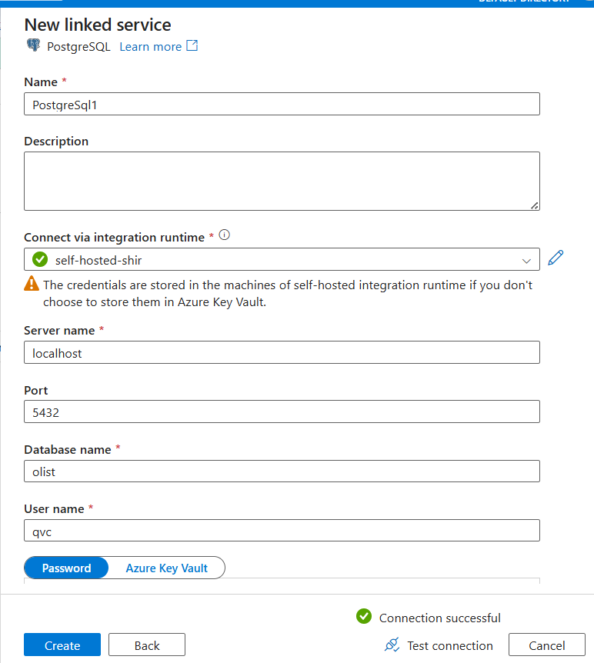
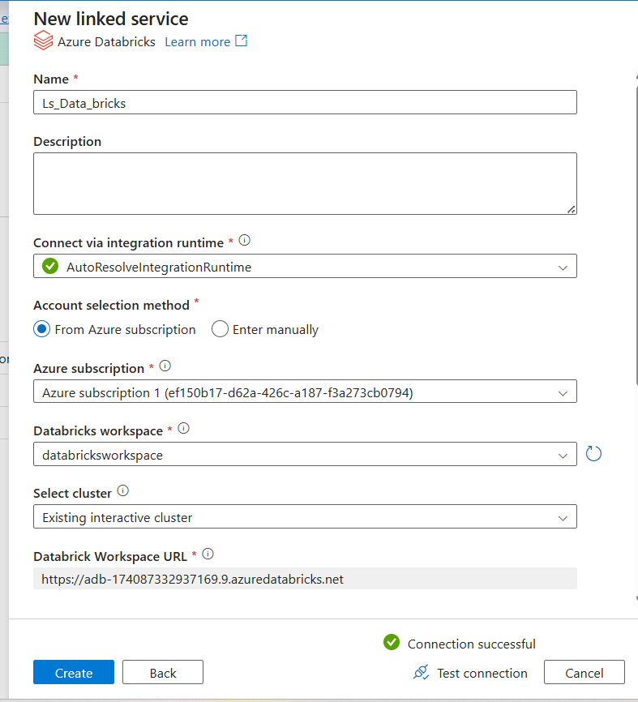
CLOUD EXECUTION
Evidence — ADF Linked Services
PostgreSQL linked service via self-hosted-shir — connection successful
Azure Databricks linked service — connection successful

Slide 11
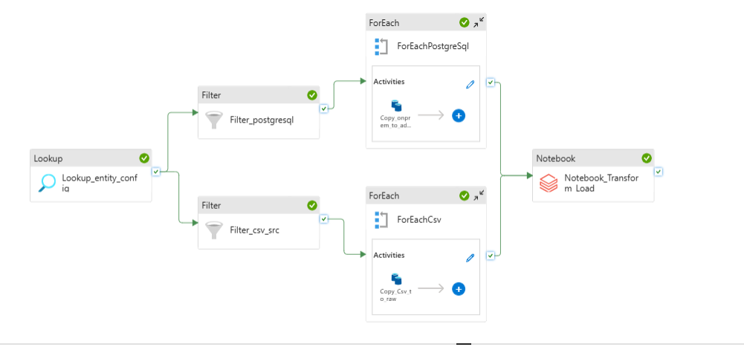
CLOUD EXECUTION
Evidence — Pipeline Run (End-to-End)
pl_olist_ingest: Lookup → Filter ×2 → ForEach ×2 (9 parameterised copies) → Notebook_Transform_Load — all activities succeeded

Slide 12
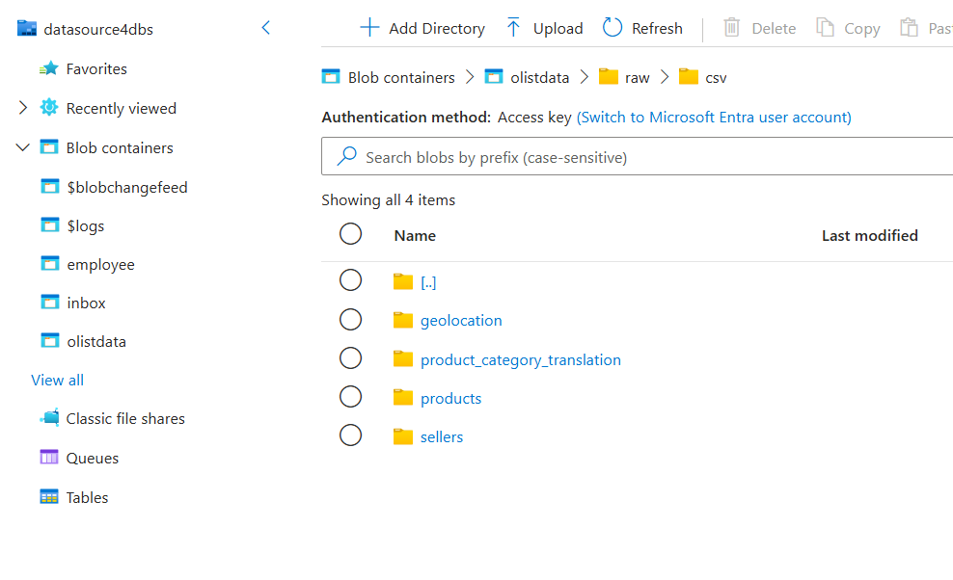
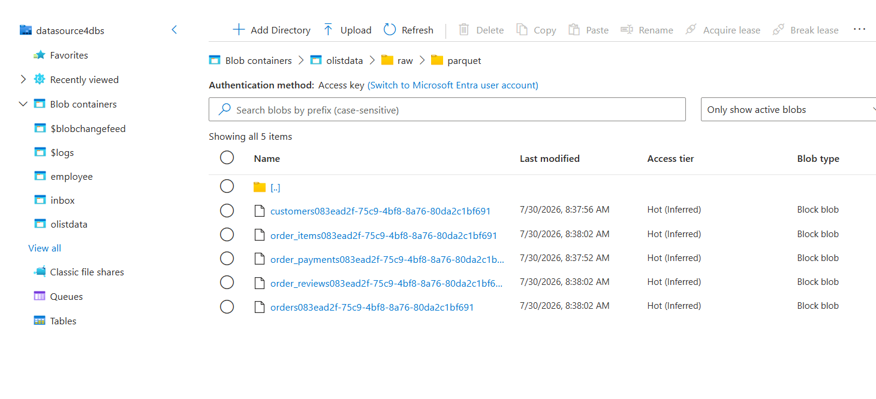
CLOUD EXECUTION
Evidence — Landing Zone (ADLS Gen2)
inbox/ — 4 reference CSVs (geolocation, product_category_translation, products, sellers)
raw/parquet/ — run-scoped Postgres extracts, named <entity><RunId>

Slide 13
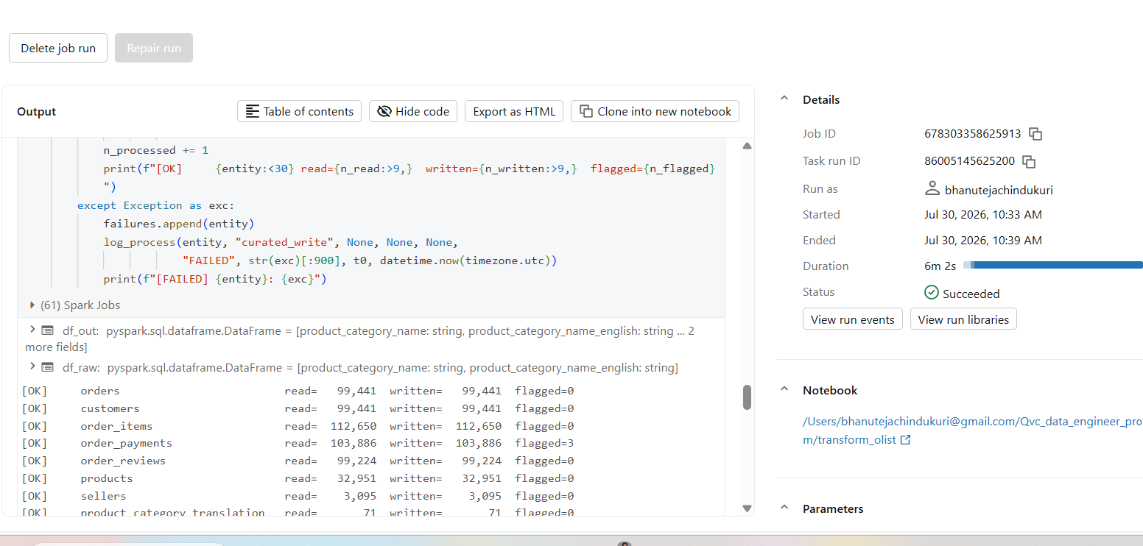
CLOUD EXECUTION
Evidence — Databricks Transform Run
transform_olist notebook job — Succeeded in 6m 2s; per-entity read/written/flagged counts match the documented figures exactly

Slide 14
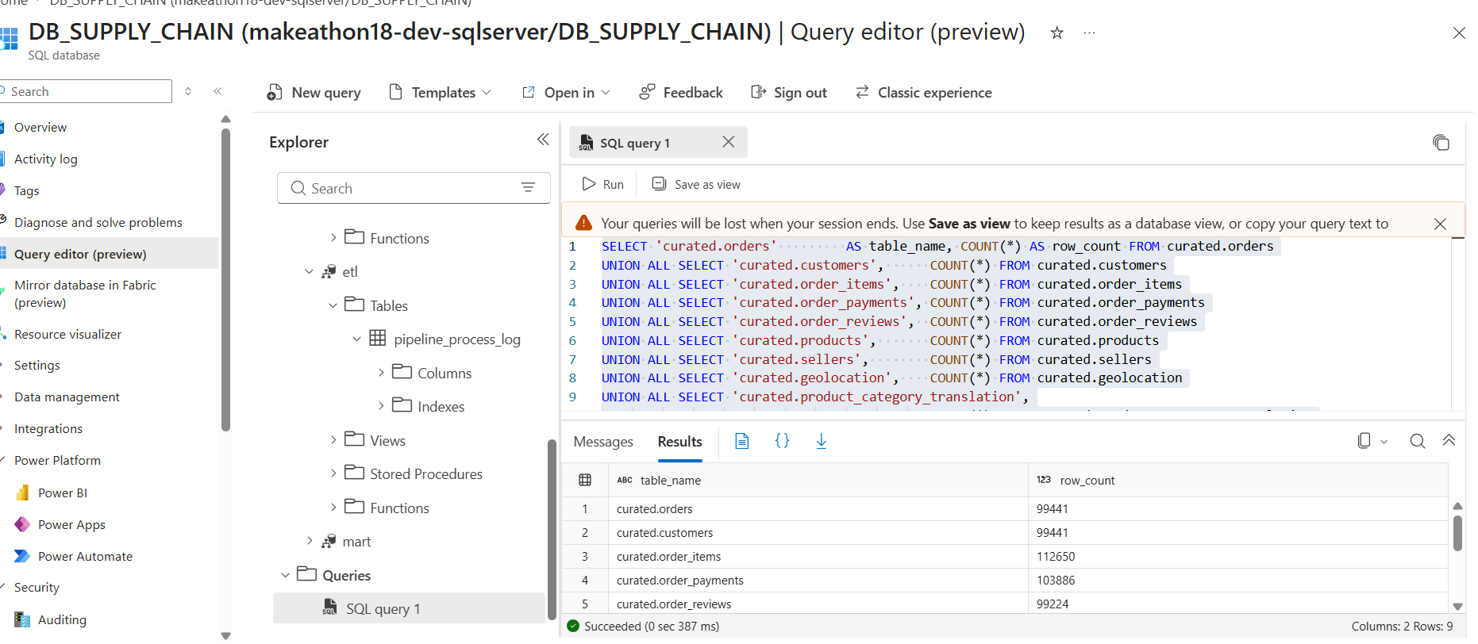
CLOUD EXECUTION
Evidence — Curated Load Reconciliation
Azure SQL query editor — curated.* row counts: orders 99,441 · customers 99,441 · order_items 112,650 · order_payments 103,886 · order_reviews 99,224

Slide 15
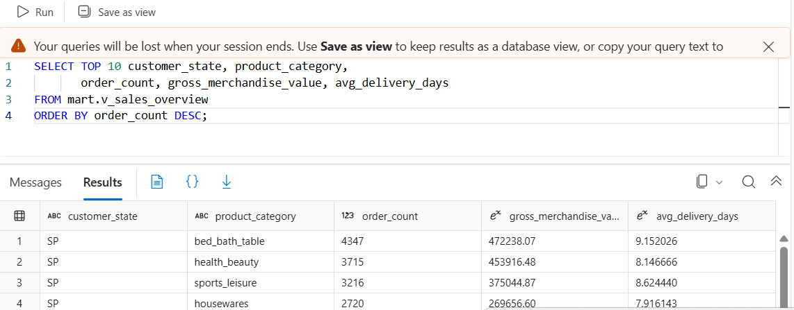
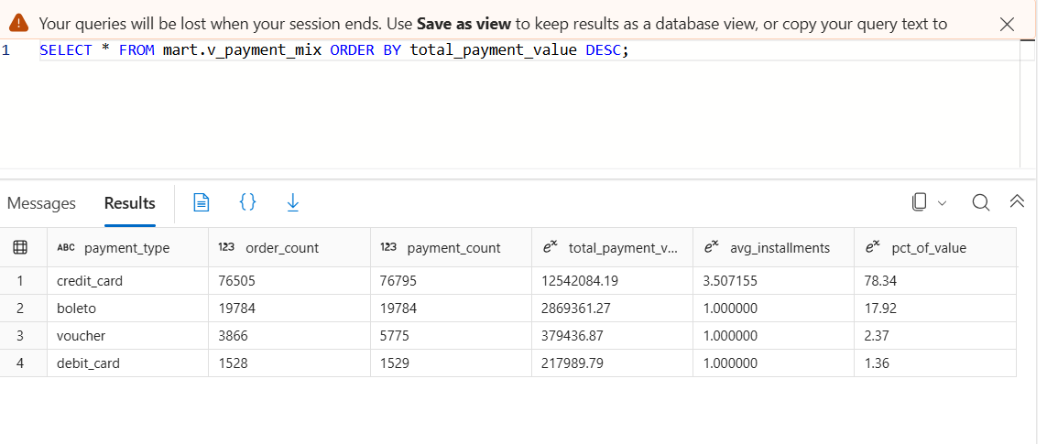
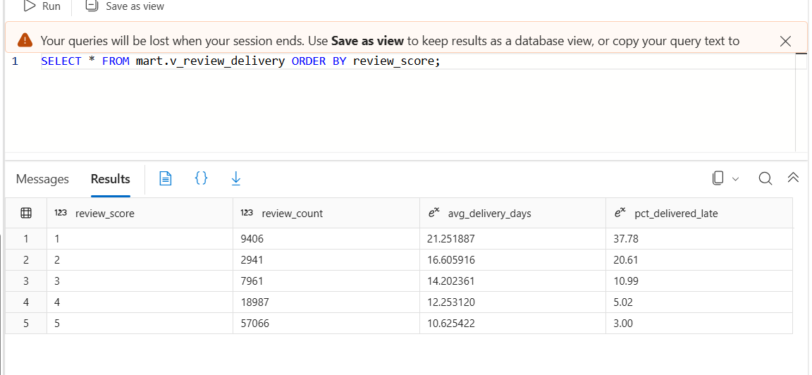
CLOUD EXECUTION
Evidence — Mart Outputs
v_sales_overview — top states × categories by order count
v_payment_mix — full 4-row output
v_review_delivery — full 5-row output

Slide 16
ASSUMPTIONS & TRADE-OFFS
Key Decisions
▪ Local Docker Postgres behind a Self-Hosted IR as the relational source — Azure PG was not provisionable in this subscription; the SHIR pattern is the honest equivalent of production on-prem sources.
▪ Verified parquet-extract fallback removes even the laptop-uptime risk for re-runs — a single ADF source-dataset swap, everything downstream identical.
▪ Full reload (truncate-load) per run — appropriate for the volume/scope; incremental is designed but not implemented (see productionising).
▪ Failure isolation per entity — one failing entity is logged FAILED in the process log; the other eight still load; the run fails at the end so Monitor shows red.
▪ No Azure Key Vault, no role assignments anywhere — this subscription blocks granting Key Vault access and assigning any Azure role. Secrets are secure strings in ADF linked services and a Databricks-native secret scope instead.
▪ Single-node smallest Databricks cluster, 15-min auto-terminate — right-sized for ~1.55M rows; transforms are partition-agnostic and scale to a multi-node cluster unchanged.

Slide 17
ROADMAP
Productionising for a Daily/Monthly Schedule
▪ Incremental extraction — watermark control table; ADF Lookup reads the high-water mark; CDC/Debezium if the source gains change tracking.
▪ Merge instead of truncate-load — stage + keyed MERGE into curated; opens the door to SCD2 on customers/sellers.
▪ Reference data cadence — geolocation and category translation are slowly changing; refresh monthly, not per run.
▪ Trigger & recovery — tumbling-window trigger with retry; idempotency already guaranteed by run-scoped raw folders.
▪ Alerting & observability — Azure Monitor alerts on pipeline failure and reconciliation drift; lifecycle management on the raw zone.
▪ Security hardening — private endpoints, managed identity end-to-end, TLS to the source, secret rotation.
▪ CI/CD — factory attached to Git; transform logic migrated to dbt as the model count grows.
▪ Cost at scale — job clusters (spot-backed); partitioned parallel copies; Synapse/Fabric only when volume justifies it.

Slide 18
Questions
Repository: Data Pipeline Exercise/ · Full Olist dataset reviewed locally before the cloud run

